Slide 1

Solving the Most Critical Problem in the World
PARIS
Patient Augmented Reality Information System

Slide 2




Notes:
Problem

Slide 3
Benefits
Keeps healthcare providers safe
Lower Hospital Acquired Infection (HAI) rates
Less time spent on EHR
Efficient change of shift handoff

Slide 4
Business Opportunity
B2B partner opportunities:
Small to Medium Hospitals
Nursing Homes

Slide 5
Go-to-Market Strategy
Step 1: Partner with a hospital for POC
Step 2: Partner with healthcare marketing consultant for sales
Step 3: Market roll-out
Notes:
POC – Proof of concept
Revenue Stream – Subscription + Customization

Slide 6
Revenue Streams
Yearly subscription rate (based on hospital size)
Customization (scope dependent)
Notes:
POC – Proof of concept
Revenue Stream – Subscription + Customization

Slide 7
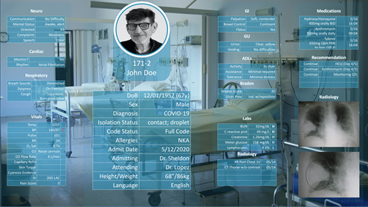

Notes:
In the future, this app could run on headsets/ glasses and provide hands free and heads-up display of patient information via AR (augmented reality).

Slide 8



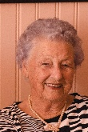



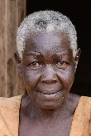

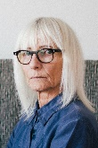
97%
97%
Aggregated
Patient
Real-time
Information
Log
Room: 117-1
Name: James, Shelby
Room: 117-1
Name: James, Shelby
Room: 117-1
Name: James, Shelby
Room: 117-1
A.P.R.I.L
Name: James, Shelby
Room: 117-1
Name: James, Shelby

Slide 9




97%
97%
97%
97%
Room: 117-1
DoB | 12/01/1952 (67y)
Sex | Male
Diagnosis | COVID-19
Isolation Status | contact; droplet
Code Status | Full Code
Allergies | NKA
Admit Date | 5/12/2020
Admitting | Dr. Sheldon
Attending | Dr. Lopez
Height/Weight | 68”/86kg
Language | English
Name: James, Shelby
Scroll
Search
Room: 117-1
Name: James, Shelby
Room: 117-1
Name: James, Shelby
Room: 117-1
Name: James, Shelby
Room: 117-1
Name: James, Shelby

Slide 10
97%
97%
Room: 117-1
Name: James, Shelby
Neuro
Communication | No Difficulty
Mental Status | Awake, alert
Oriented | X3
Complaints | Weakness
Speech | Clear
Real-time
Cardiac
Monitor? | Yes
Rhythm | Atrial Fibrillation
Respiratory
Breath Sounds | Diminished
Dyspnea | On Exertion
Cough | Occasional, Non-productive

Slide 11
97%
97%
Room: 117-1
Name: James, Shelby
GI
Palpation | Soft, nontender
Bowel Control | Continent
Flatus | Yes
Hand-off
GU
Urine | Clear, yellow
Voiding | No difficulties
ADLs
Activity | In chair
Assistance | Minimal required
Tolerance | Minimal distress
Braden
Braden Score | 20
Ulcer Prev | Ind. w/reposition

Slide 12
97%
97%
Room: 117-1
Name: James, Shelby
Labs
BUN | H | 32mg/dL
C-reactive prot | H | 49 mg/L
Creatinine | H | 1.26mg/dL
Meter glucose | H | 158 mg/dL
Lymphocytes | L | 9.1%
Radiology
XR Port Chest 1V | 05/14
CT Thorax w/o contrast | 05/14

Slide 13
97%
97%
Room: 117-1
Name: James, Shelby
Medications
Hydroxychloroquine 800mg orally BID | 5/16 16:04
Azithromycin 500mg orally daily | 5/16 09:04
Tylenol 650mg Q6H PRN for fever >100.3F | 5/16 16:04
Recommendation
Continue | HCQ (Day 4/5)
Continue | Azithromycin (Day 4/5)
Continue | Monitoring QTc

Slide 14
Team
Lee Englestone Software Dev Manager
Shruti Sachar MSN, RN
Megan Chan BSN, RN
Sean Scott IT Manager, Agile Coach, and PowerPoint Guru
Joanna Maw PA-S, BSRN (student)

Slide 15
Thank You!

